Slide 1
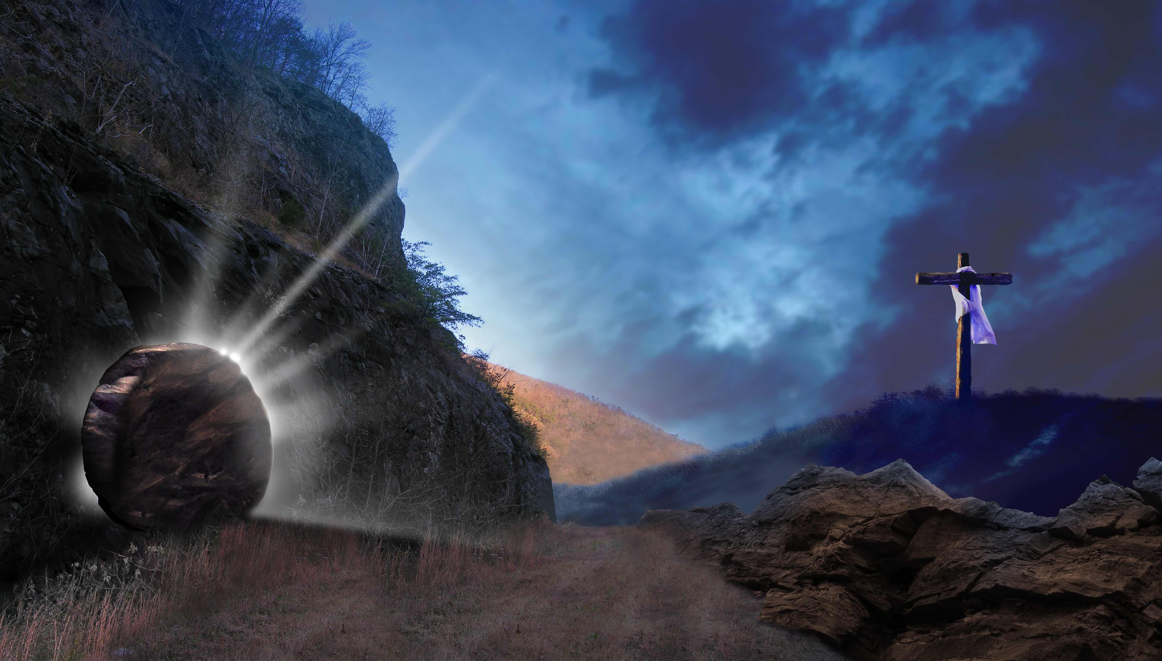
耶稣，你是复活的主 Jesus the Resurrected Lord
词曲：小草
This Photo by Unknown Author is licensed under CC BY-NC
This Photo by Unknown Author is licensed under CC BY-NC

Slide 2
耶稣你是复活的主
你满有荣耀掌权在天
罪恶死亡已被你胜过
得胜的凯歌响遍宇宙间
Jesus, You are the resurrected Lord, full of glory in heaven
You have overcome death, your victory proclaims through the universe

Slide 3
耶稣你是复活的主
你满有能力在我心中
痛苦患难不再压伤我
赞美的颂歌我天天高唱
Jesus, You are the resurrected Lord, Your power fills me
Pains and sufferings can’t overcome me, I praise you every day

Slide 4
耶稣你是复活的主
你是我的力量和帮助
耶稣你是复活的主
你是我的安慰和渴慕
Jesus, You are the resurrected Lord, You are my strength and help.
Jesus, You are the resurrected Lord, You are my comforter, I desire You

Slide 5
耶稣你是复活的主
你是我的喜乐和盼望
耶稣你是复活的主
你是我生命的亮光
Jesus, You are the resurrected Lord, You are my joy and hope.
Jesus, You are the resurrected Lord, You are the light of my life.

Slide 6
耶稣你是复活的主
你满有荣耀掌权在天
罪恶死亡已被你胜过
得胜的凯歌响遍宇宙间
Jesus, You are the resurrected Lord, full of glory in heaven
You have overcome death, your victory proclaims through the universe

Slide 7
耶稣你是复活的主
你满有能力在我心中
痛苦患难不再压伤我
赞美的颂歌我天天高唱
Jesus, You are the resurrected Lord, Your power fills me
Pains and sufferings can’t overcome me, I praise you every day

Slide 8
耶稣你是复活的主
你是我的力量和帮助
耶稣你是复活的主
你是我的安慰和渴慕
Jesus, You are the resurrected Lord, You are my strength and help.
Jesus, You are the resurrected Lord, You are my comforter, I desire You

Slide 9
耶稣你是复活的主
你是我的喜乐和盼望
耶稣你是复活的主
你是我生命的亮光
Jesus, You are the resurrected Lord, You are my joy and hope.
Jesus, You are the resurrected Lord, You are the light of my life.

Slide 10
耶稣你是复活的主
你是我的力量和帮助
耶稣你是复活的主
你是我的安慰和渴慕
Jesus, You are the resurrected Lord, You are my strength and help.
Jesus, You are the resurrected Lord, You are my comforter, I desire You

Slide 11
耶稣你是复活的主
你是我的喜乐和盼望
耶稣你是复活的主
你是我生命的亮光
Jesus, You are the resurrected Lord, You are my joy and hope.
Jesus, You are the resurrected Lord, You are the light of my life.

